Slide 1

Capstone Design (2)
6th week : Life Sports Total Solution
Date | 2019.04.08
Presenter | 공찬형
Team | 공찬형, 금강현, 이동현

Slide 2
Index
Implementation
Backend
Frontend
Database
Troubleshooting
Spring Issues
Project Schedule
Personal Project Schedule
Q & A

Slide 3
Implementation

Slide 4
1. Implementation
Serverside
Build connection between mybatis & mysql database
Mybatis Manager in Java - Mysql database (AWS ec2)
Write SQL in SQLMapper syntax (In .xml)
Make rules to manage URLs
*.do : For preventing collision among servlet mappers
RESTful API : based on RESTful APIs like get, post, insert …
We decide to use “*.do” pattern URLs
Implement Controller, Service, DAO class

Slide 5
1. Implementation
Controller – Service – DAO - SQL
Request
Model & View
Controller
Service
DAO
(Data Access Object)
SQL
- Manage URL
- Business logic
- Some algorithm
- Data Access
- Act like Struct

Slide 6
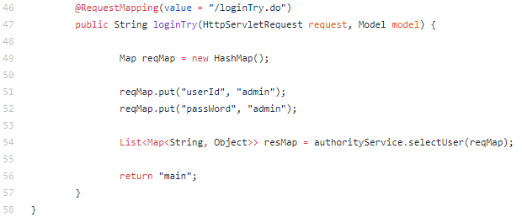
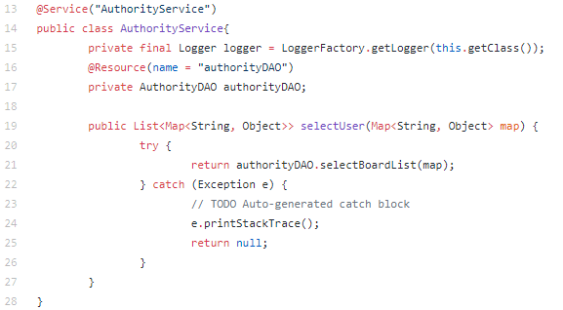
1. Implementation
Controller – Service – DAO - SQL

Slide 7
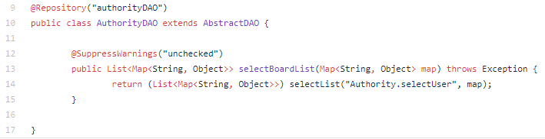
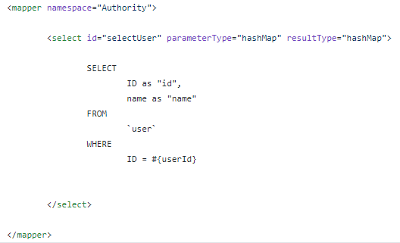
1. Implementation
Controller – Service – DAO - SQL

Slide 8
1. Implementation
Frontend
Modify fullcalander API to fit in our purpose
Actions : Dragging motions
Datatype : make it fit in our own schema
Study about AJAX for asynchronized request for some reservation data
At the first time, we decide to client makes some reloads to refresh the pages with new informations,
But now… With AJAX….
Conflicts occur -> Rebuild Pages.

Slide 9
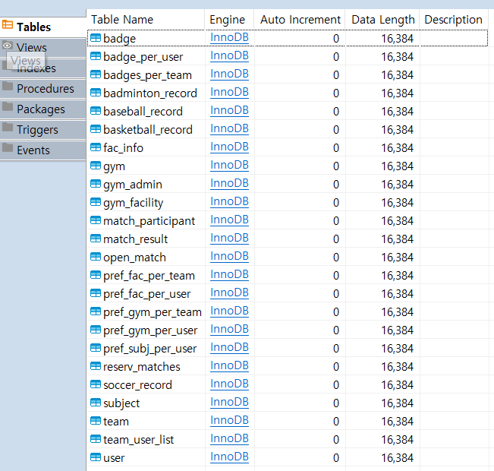
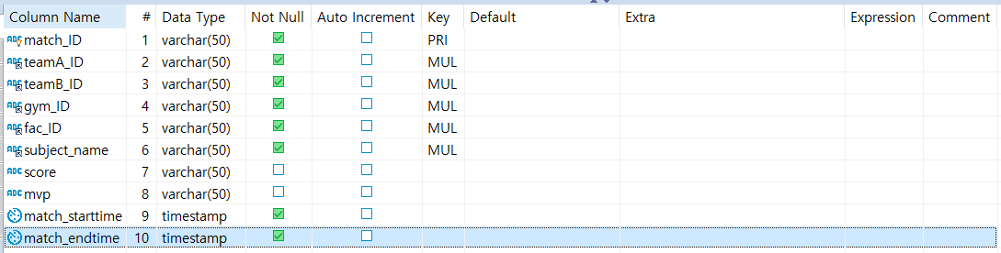
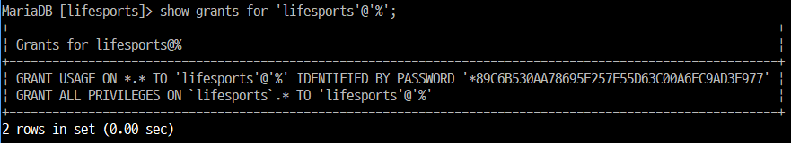
1. Implementation
Database
Enable remote access using account ‘lifesports’ with full privileges for DB connection for Web server
Use Dbeaver for database tool
Table Generation & Modification
Physical schema generation with Unique Key / Foreign Key / Primary Key

Slide 10
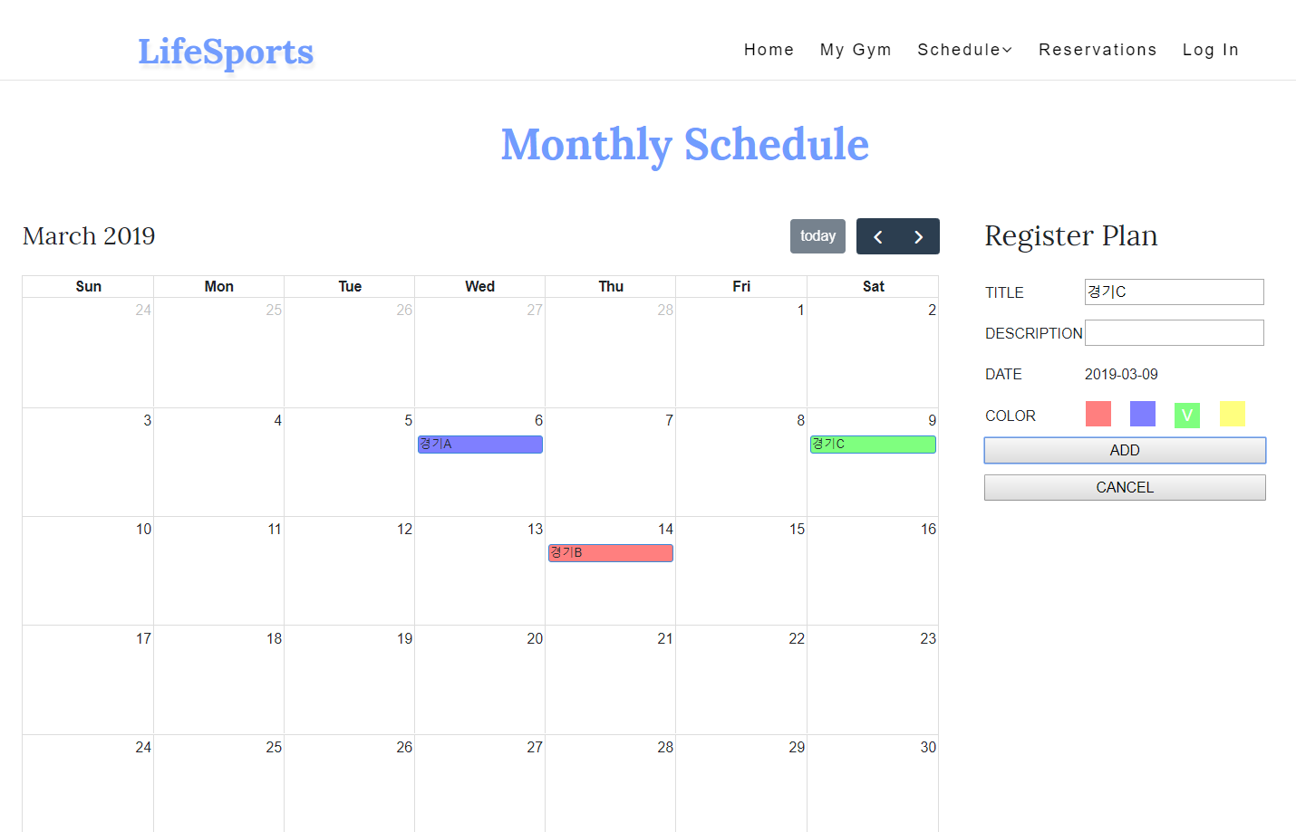
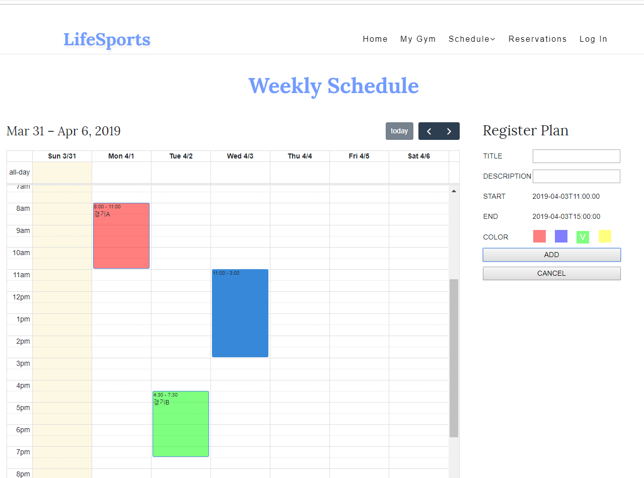
1. Implementation
Database
Create queries for each event in Web page(On-going)
Gym/Facility Info – Gym/Facility registration, Gym/Facility info modification, Gym/Facility deletion
Gym/Facility Schedule – Select / Insert / Update / Delete weekly or monthly schedule
Look up a reservation schedule by gym/facility and by week/month
Login

Slide 11
Troubleshooting

Slide 12
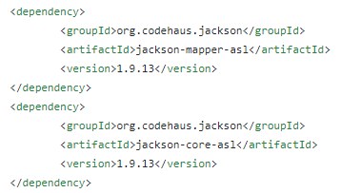
2. Troubleshooting
Spring - Ajax Issue
Spring 4.0 – JacksonJsonView Conflict
It isn’t clear which one is cause of problem (Spring? JacksonJsonView?)
We decide to use other repository

Slide 13
Project Schdule

Slide 14
3. How to Implement
Dates Task Descriptions | March |  |  |  | April |  |  |  |  | May |  |  |  | June
 | 4 | 11 | 18 | 25 | 1 | 8 | 15 | 22 | 29 | 6 | 13 | 20 | 27 | 3 | 10 | 17
Team Organization |  |  |  |  |  |  | Midterm Demonstration & Presentation |  |  |  |  |  |  | Final Demonstration & Presentation
Subject Confirmation / Write out the Proposal
Web UI Design
Web Structure Construction
Data collection & Generation / Data modeling
Database Construction
App UI Design
App Structure Construction
Functional Implementation : Manager Web Site
Functional Implementation : Reservation (App)
Hadoop Installation / CDH Cluster Construction
Data Analysis using Hadoop Cluster
Functional Implementation : Matching Service (App)
Functional Implementation : Ranking System (App)
Test and Debugging
Preparing for Final Demo
Writing Manuals and Reports

Slide 15
Personal Project Schedule

Slide 16
5. Personal Project Schedule
Lee, Donghyun : DB Construction & Data Analysis, Recommendation Implementation
Dates | March |  |  |  | April |  |  |  |  | May |  |  |  | June
Task Descriptions | 4 | 11 | 18 | 25 | 1 | 8 | 15 | 22 | 29 | 6 | 13 | 20 | 27 | 3 | 10 | 17
Team Organization |  |  |  |  |  |  | Midterm Demonstration & Presentation |  |  |  |  |  |  | Final Demonstration & Presentation
Subject Confirmation / Write out the Proposal
Data collection & Generation / Data modeling
Database Construction
Hadoop Installation / CDH Cluster Construction
Data Analysis using Hadoop Cluster
Functional Implementation : Matching Service (App)
Functional Implementation : Ranking System (App)
Test and Debugging
Preparing for Final Demo
Writing Manuals and Reports

Slide 17
5. Personal Project Schedule
Gong, Chanhyung : Web Structure construction, Web & app implementation
Dates | March |  |  |  | April |  |  |  |  | May |  |  |  | June
Task Descriptions | 4 | 11 | 18 | 25 | 1 | 8 | 15 | 22 | 29 | 6 | 13 | 20 | 27 | 3 | 10 | 17
Team Organization |  |  |  |  |  |  | Midterm Demonstration & Presentation |  |  |  |  |  |  | Final Demonstration & Presentation
Subject Confirmation / Write out the Proposal
Web UI Design
Web Structure Construction
Functional Implementation : Manager Web Site
Functional Implementation : Matching Service (App)
Functional Implementation : Ranking System (App)
Test and Debugging
Preparing for Final Demo
Writing Manuals and Reports

Slide 18
5. Personal Project Schedule
Kum, Kanghyun : App Structure construction, Web & App implementation
Dates | March |  |  |  | April |  |  |  |  | May |  |  |  | June
Task Descriptions | 4 | 11 | 18 | 25 | 1 | 8 | 15 | 22 | 29 | 6 | 13 | 20 | 27 | 3 | 10 | 17
Team Organization |  |  |  |  |  |  | Midterm Demonstration & Presentation |  |  |  |  |  |  | Final Demonstration & Presentation
Subject Confirmation / Write out the Proposal
App UI Design
App Structure Construction
Functional Implementation : Manager Web Site
Functional Implementation : Reservation (App)
Functional Implementation : Matching Service (App)
Functional Implementation : Ranking System (App)
Test and Debugging
Preparing for Final Demo
Writing Manuals and Reports

Slide 19
Q & A

